Slide 1


Titolo presentazione sottotitolo
Constrained numerical optimization for estimation and control
Offline estimation of the human force acting on the end-effector of a
collaborative robot and online optimal control of the torque
Luca Brolese – Andrea Ghezzi – Rodrigo Senofieni
A.A. 2018/2019
Titolo presentazione sottotitolo
Offline estimation of the human force acting on the end-end-effctor of a
collaborative robot and online optimal control of the torque
Milano, XX mese 20XX
Milano, XX mese 20XX
Fare clic per modificare lo stile del sottotitolo dello schema

Slide 2

Working scenario
Growth of collaborative robotics
A common task: load transportation and manipulation
Create a more friendly and safety environment for workers

Slide 3
Two problems «solved»
Estimation phase
Optimal control phase
Virtual force sensor
Optimal torques

Slide 4
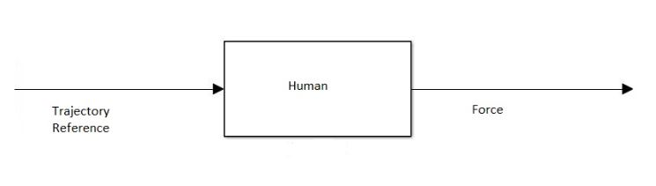
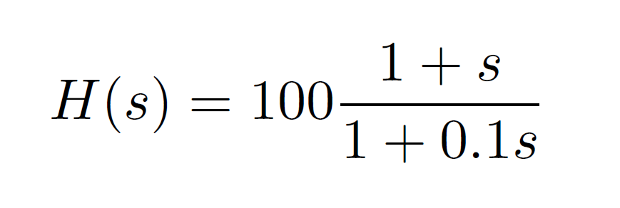
Problem modelling - Human
The modelling of the human can result in a very complex task
Possible approach: extract the most important aspects of the human behaviour
It can be modelled with a first order transfer function (zero, pole, gain)
Parameters tuning via trial & error

Slide 5
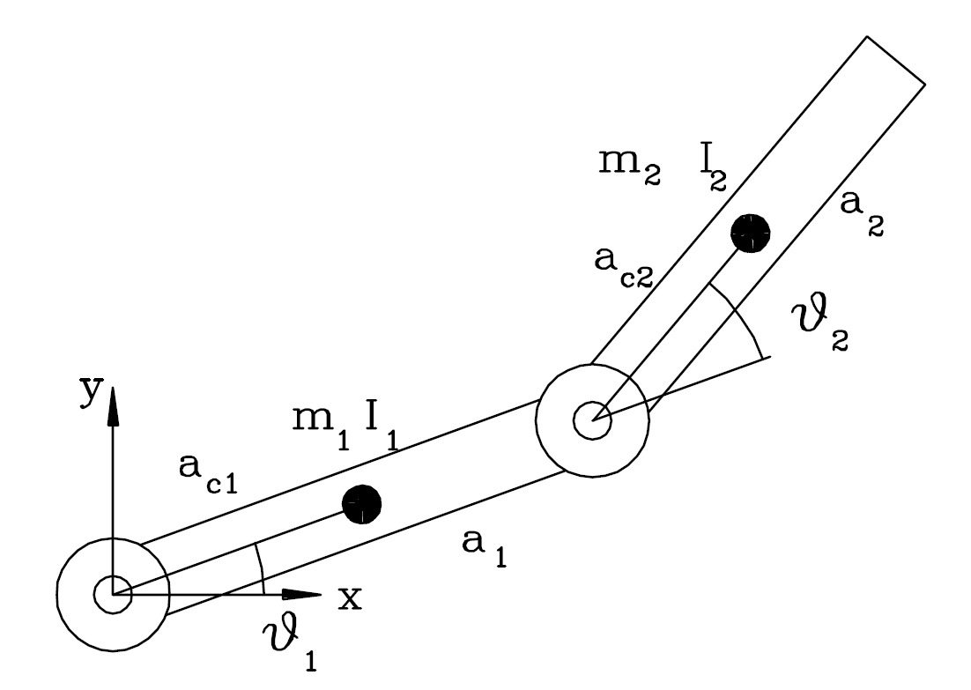
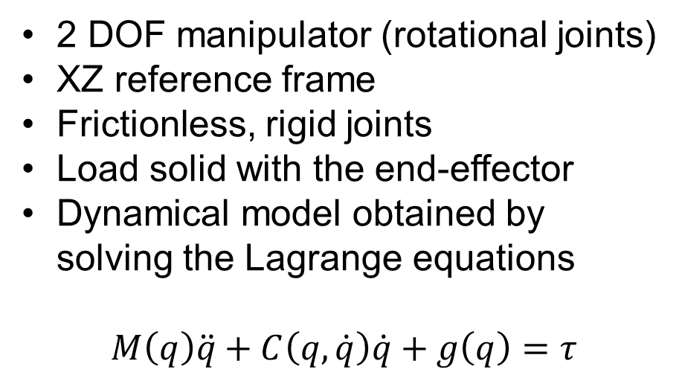
Problem modelling - Robot
2 DOF manipulator (rotational joints)
XZ reference frame
Frictionless, rigid joints
Load solid with the end-effector
Dynamical model obtained by solving the Lagrange equations
$$M\left(q\right)\ddot{q}+C\left(q,\dot{q}\right)\dot{q}+g\left(q\right)=τ$$

Slide 6
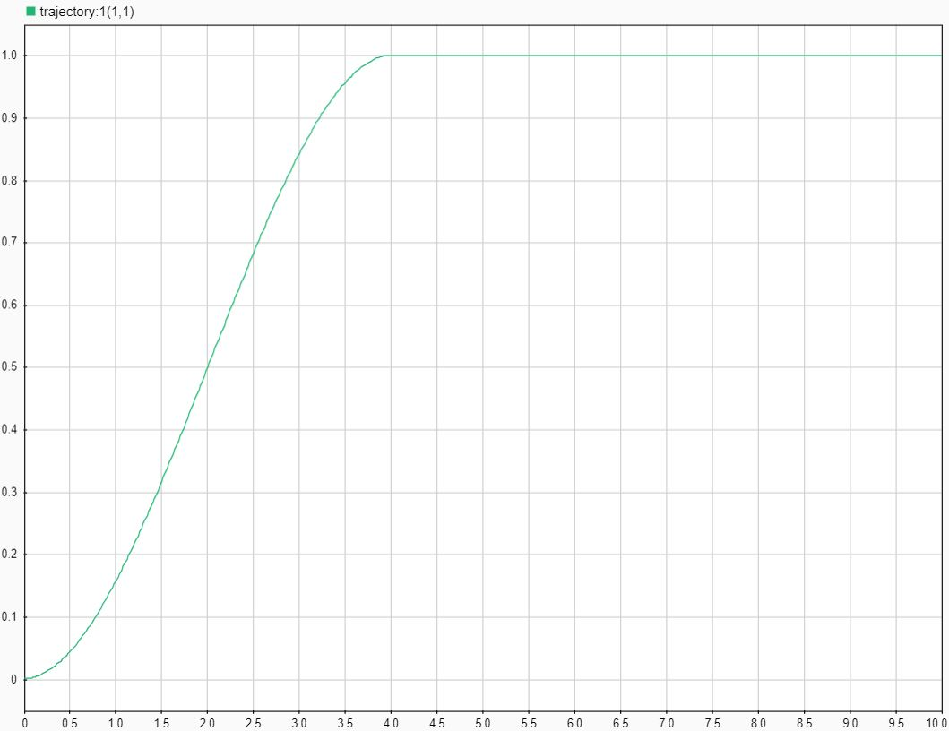
Working environment
Worker is in the origin of the reference frame (0,0)
Robot is placed 0.5 meter on the right of the worker (0.5,0)
The final point is (1,1)
The trajectory is a 3rd order polynomial function
4 seconds transient
6 seconds at steady state

Slide 7
Problem abstraction – Estimation phase
Human force treated as a disturbance acting on the e-e
Passive robot (no torques applied)
Steady state condition not reached due to heavy load
Reference data acquisition from Model_daq
Run optimization routine
Get the estimated human forces
Human reference forces

Slide 8
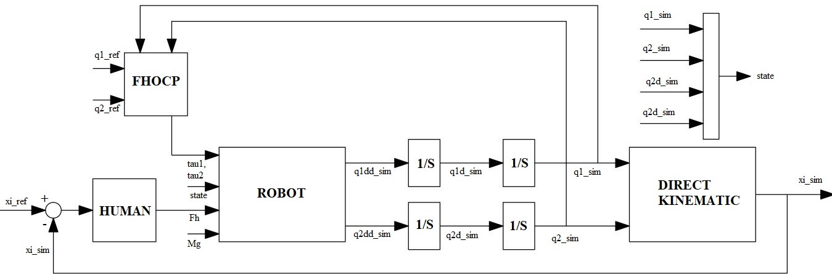
Problem abstraction – Optimal control phase
Human force treated as a disturbance acting on the e-e (unknown values)
Active robot
The human block closes the outer position loop
Steady state condition reached
Reference data acquisition from Model_daq
Run optimization routine
Get the vector of the optimal control inputs

Slide 9
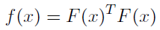
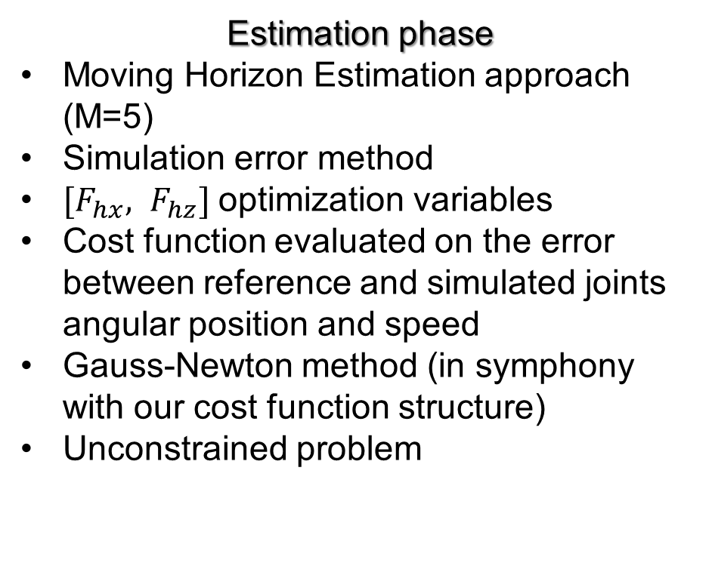
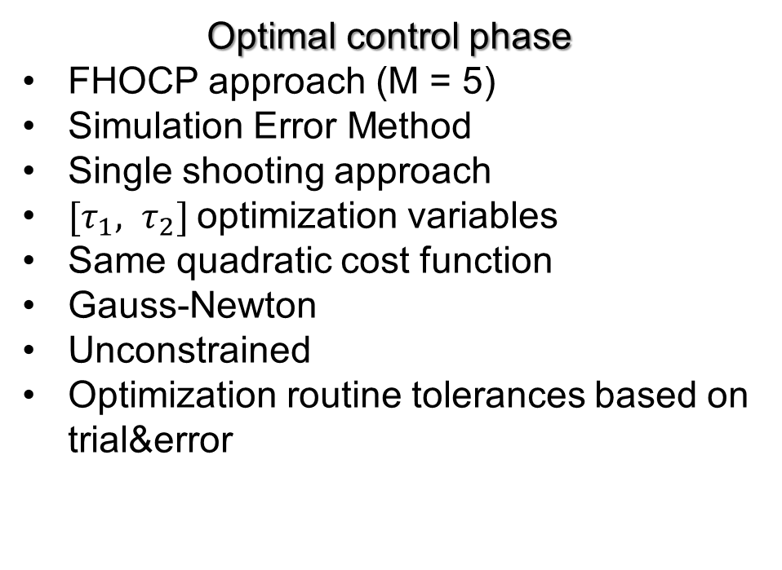
Optimization routine
Estimation phase
Moving Horizon Estimation approach (M=5)
Simulation error method
${[F}_{hx}, F_{hz}]$optimization variables
Cost function evaluated on the error between reference and simulated joints angular position and speed
Gauss-Newton method (in symphony with our cost function structure)
Unconstrained problem
Optimal control phase
FHOCP approach (M = 5)
Simulation Error Method
Single shooting approach
${[τ}_{1}, τ_{2}]$optimization variables
Same quadratic cost function
Gauss-Newton
Unconstrained
Optimization routine tolerances based on trial&error

Slide 10
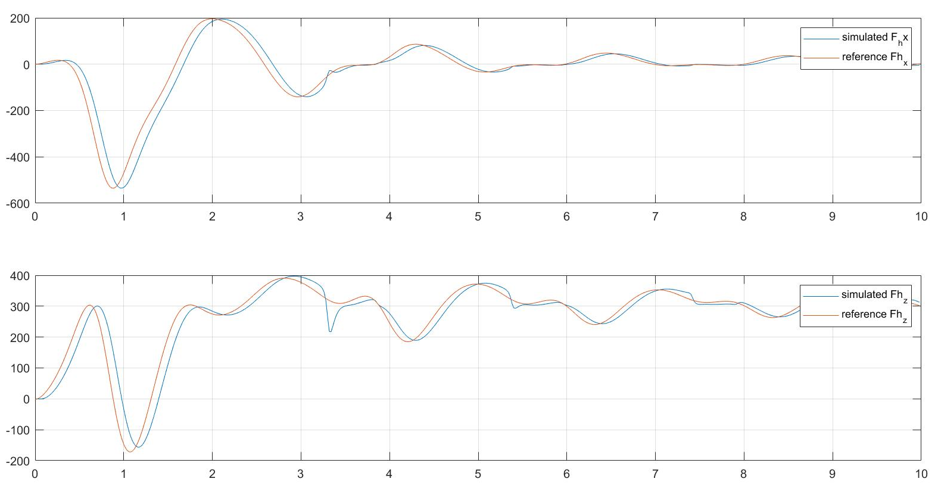
Results – Estimation phase
Good performance in forces estimation
Delay of 0.02 sec (Ts) is due to MHE approach
Irregular peaks are probably due to numerical integration problems
Computational time: 20 min
Good fitting of the load positions and speeds

Slide 11
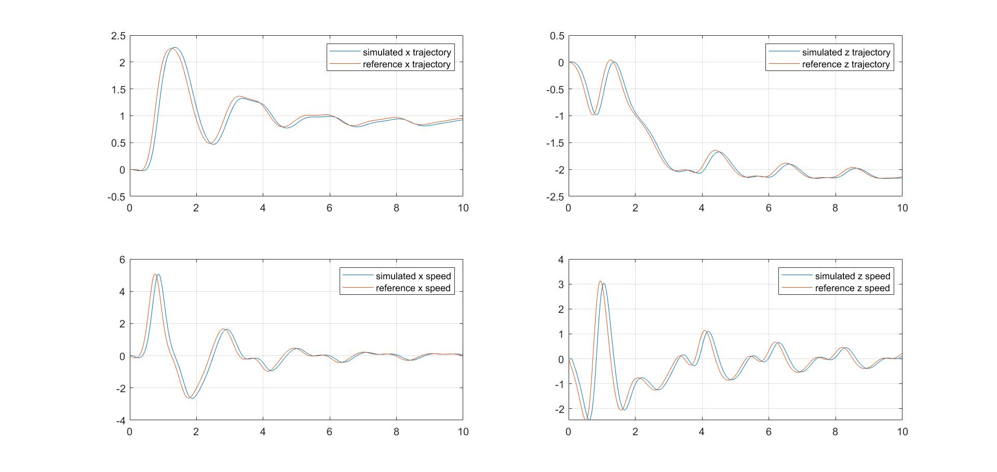
Results – Estimation phase

Slide 12
Results – Optimal control
Partially good results
Irregular peaks are probably due to:
numerical integration
Hessian inversion
Simulation time stopped at 4.5 sec – steady state condition reached
Computational time: 2:30 h

Slide 13
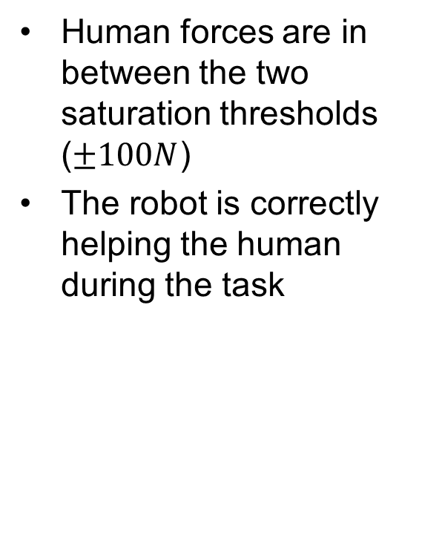
Results – Optimal control
Human forces are in between the two saturation thresholds ($±100N$)
The robot is correctly helping the human during the task

Slide 14
Results – Optimal control
Position and speed trajectories: reference vs simulated

Slide 15

Final remarks
Free noise measurements
Unconstrained approach
Robust with respect to different masses
Single shooting vs multiple shooting approach in optimal control phase

Slide 16

Q&A

